Slide 1
Digital Portfolio
STUDENT NAME: PRATHESH. M
REGISTER NO AND NMID:
DEPARTMENT: Bachelor of computer application
COLLEGE: COLLEGE/ UNIVERSITY
shanmuga industries art's and science/tiruvalluvar University
shanmuga industries art's and science/tiruvalluvar University

Slide 2
PROJECT TITLE
Personal portfolio

Slide 3


AGENDA
Problem Statement
Project Overview
End Users
Tools and Technologies
Portfolio design and Layout
Features and Functionality
Results and Screenshots
Conclusion
Github Link
3/21/2024 Annual Review

Slide 4

PROBLEM STATEMENT
1. Problem Statement Clearly explain the issue or gap your project is trying to solve. Mention why this problem is important and how it affects the target users.

Slide 5

PROJECT OVERVIEW
2. Project Overview Give a short description of your project, its main goal, and what it does. Highlight the uniqueness and scope.

Slide 6

WHO ARE THE END USERS?
Define who will use your project/product. Mention specific groups (e.g., students, developers, businesses, general public).

Slide 7

TOOLS AND TECHNIQUES
Tools and Technologies List the programming languages, frameworks, libraries, IDEs, platforms, or hardware used. Example: Python, Django, MySQL, VS Code, GitHub.

Slide 8
POTFOLIO DESIGN AND LAYOUT
Explain how you structured your portfolio or application design. Mention UI/UX choices, navigation style, and visual design aspects.
8

Slide 9
FEATURES AND FUNCTIONALITY
Features and Functionality Bullet out the key features. Example: User login and authentication Dashboard with analytics CRUD operations Responsive UI

Slide 10

RESULTS AND SCREENSHOTS
Results and Screenshots Include images or snapshots of your project working. Add output examples or demo results.
3/21/2024 Annual Review
10

Slide 11
CONCLUSION
Conclusion Summarize the outcome of the project. Mention achievements, limitations, and scope for future enhancement.
11

Slide 12
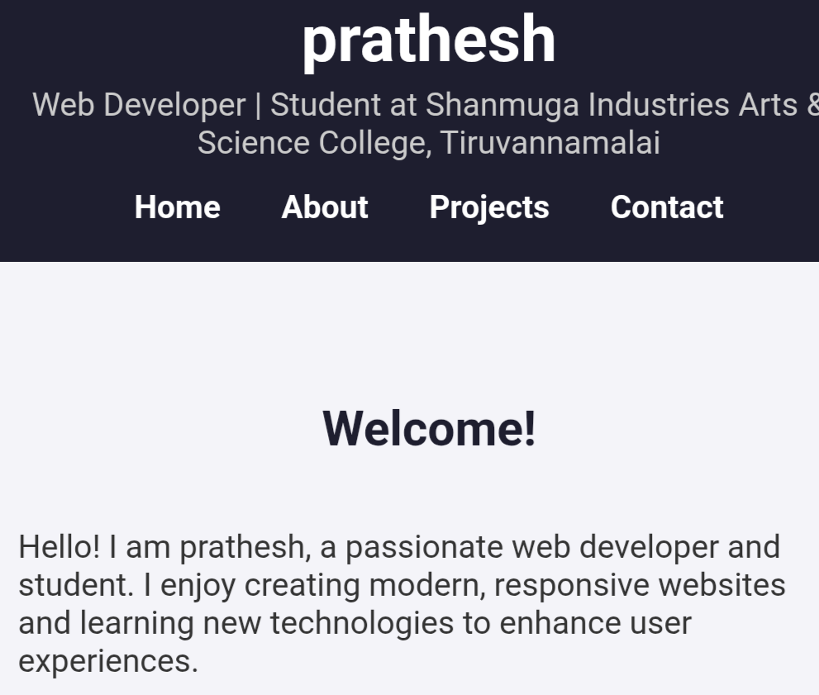
RESULTS AND SCREENSHOTS

